Slide 1




Exploring the Visualization on Movie Industry
GROUP 1

Slide 2
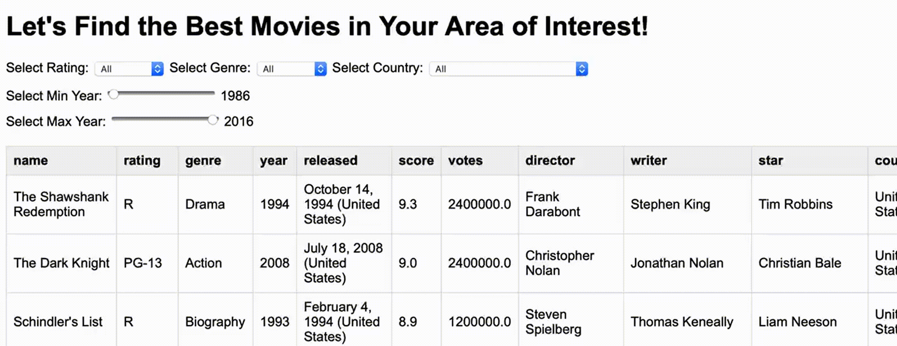
DATA DESCRIPTION
6820 MOVIES
The dataset includes various details for each movie, such as:
budget
country
220 Movies per year, 1986 - 2016
rating
release date
year

Slide 3

CONTENTS
BUDGET ANALYSIS
Movie budgets and Box office revenue
DIRECTOR/ACTOR IMPACT
Specific directors / lead actors / actresses
RELEASE ANALYSIS
Specific date patterns
MOVIE LENGTH
How movie runtime affects revenue

Slide 4

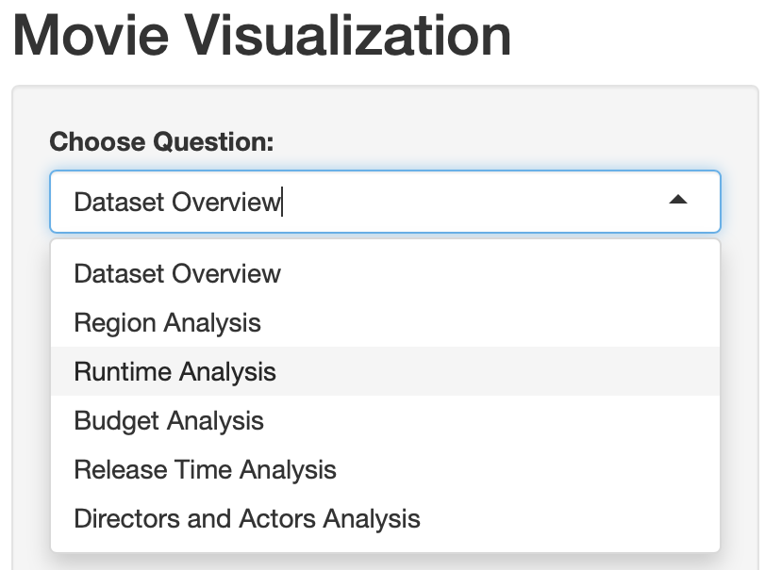
PROJECT OBJECTIVE
Develop a Shiny App with R code and D3 objects to seamlessly integrate multiple data visualizations with user-friendly interface for comprehensive data exploration.
Leverage Shiny App
Implement R code
Utilize D3 JavaScript for interactive visualization

Slide 5



01
BUDGET ANALYSIS

Slide 6


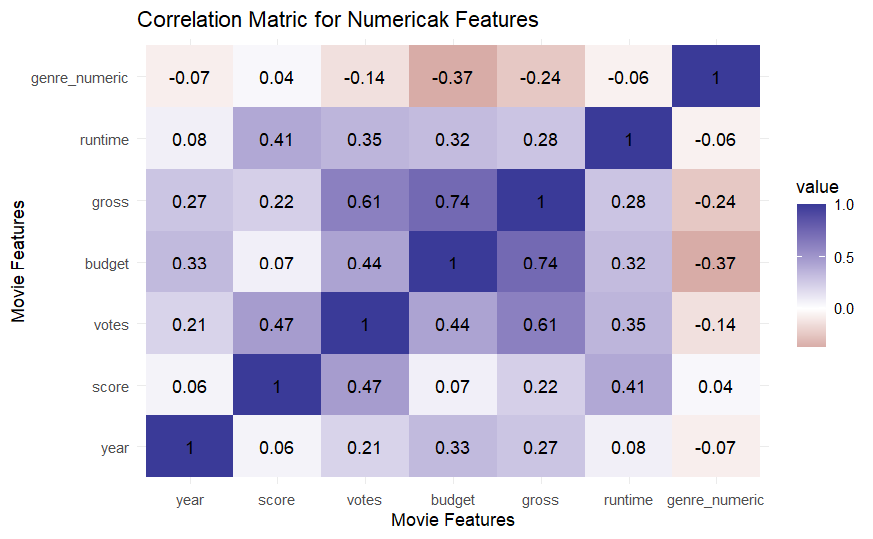
Heatmap of Correlation

Slide 7
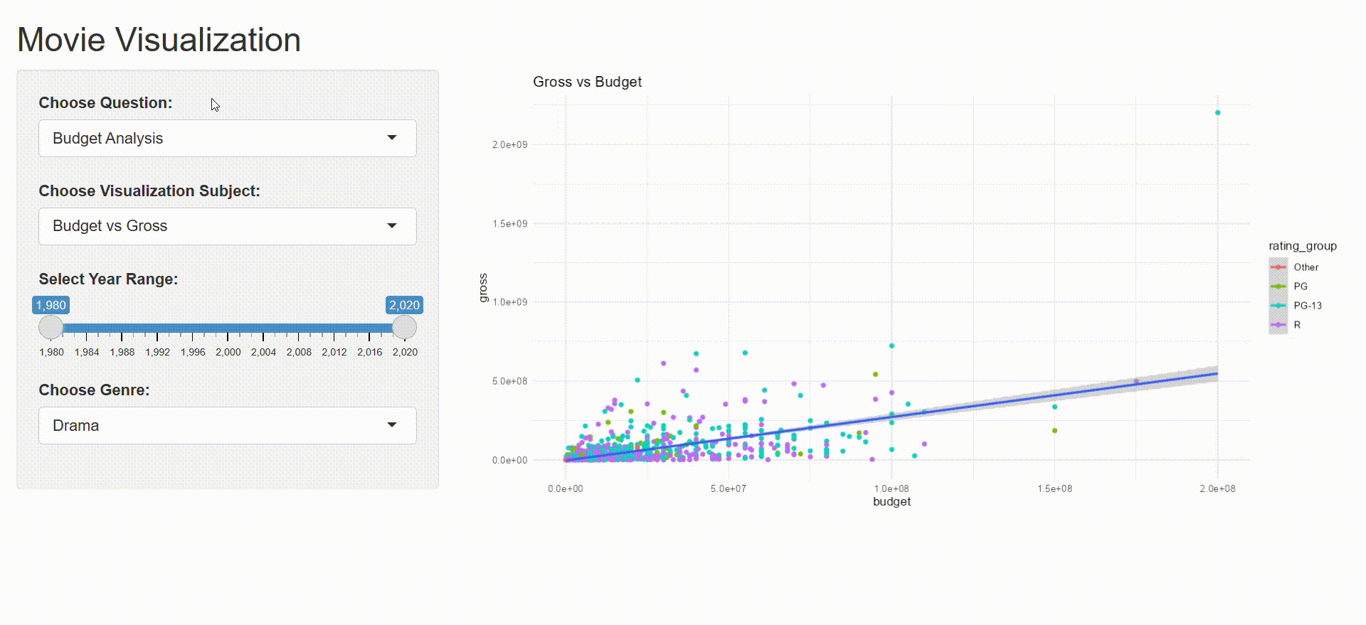
Budget vs. Gross

Slide 8
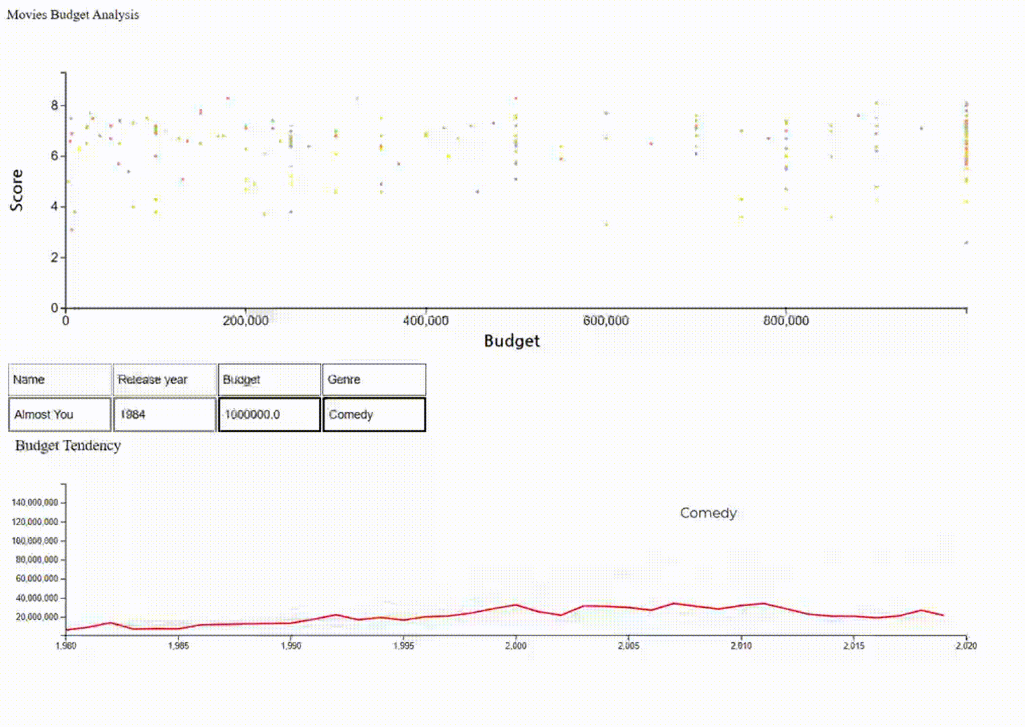
Budget vs. Score

Slide 9

02
MOVIE RELEASE

Slide 10
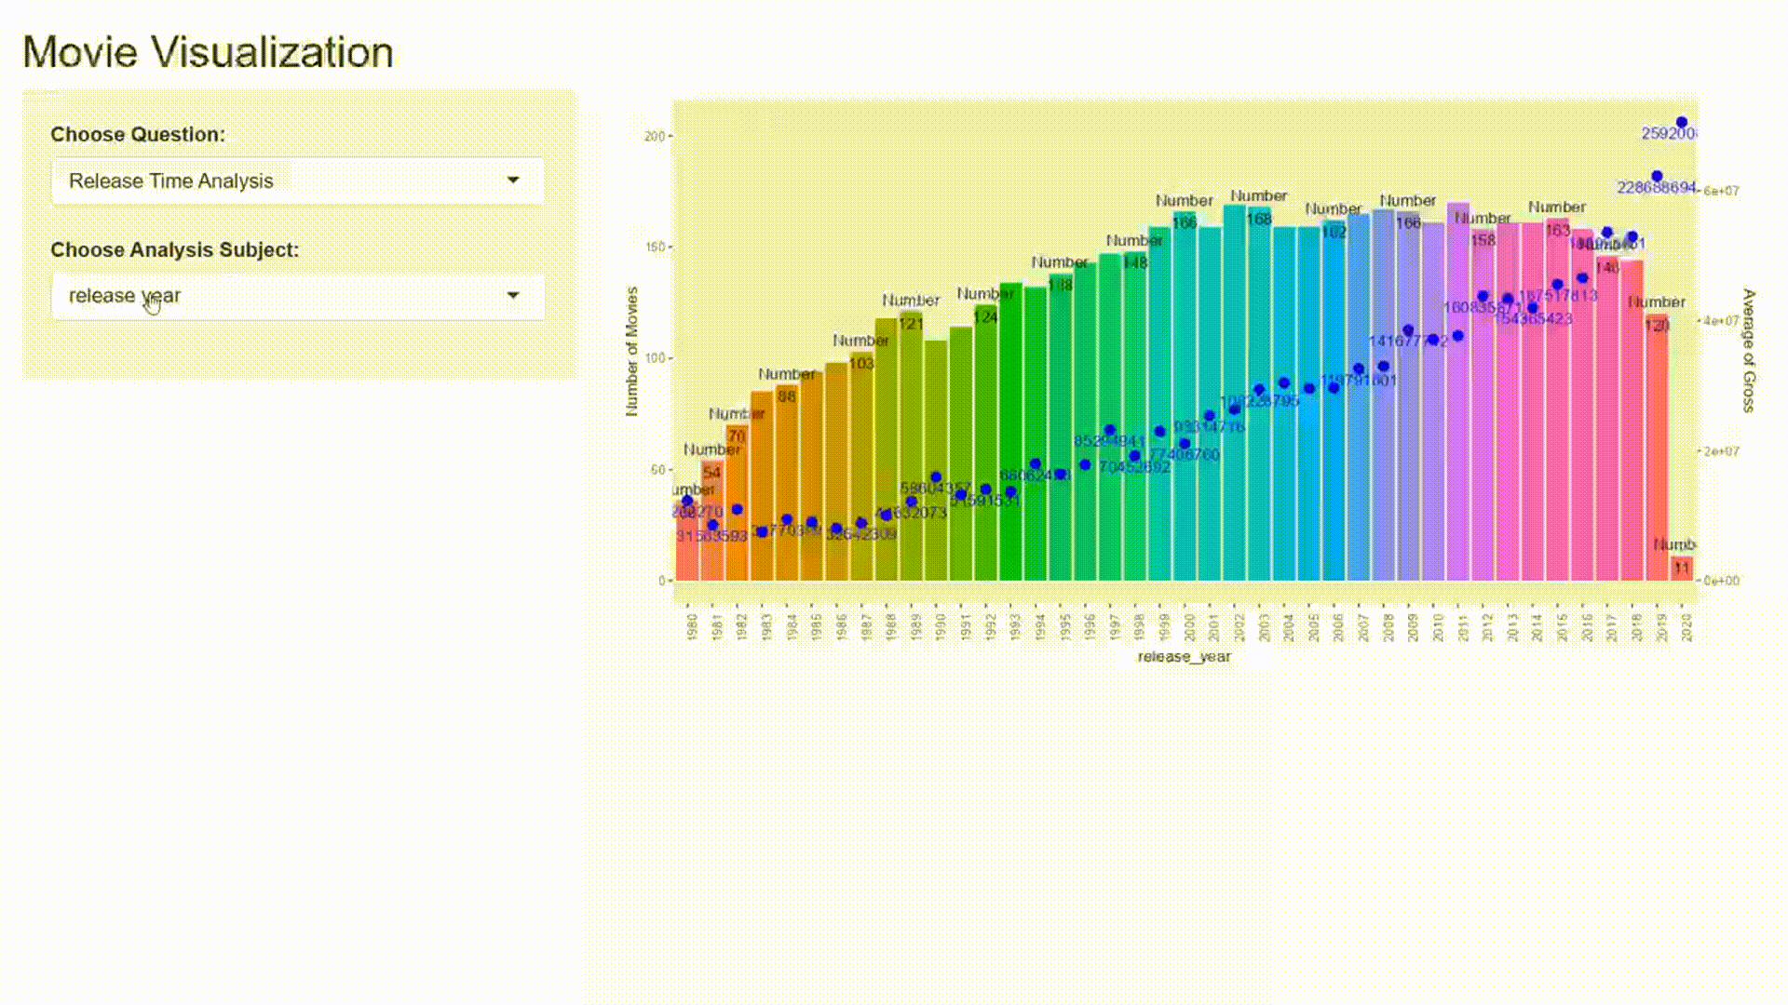
RELEASE DATE
Aim: Determine if specific release date pattern result in higher gross

Slide 11
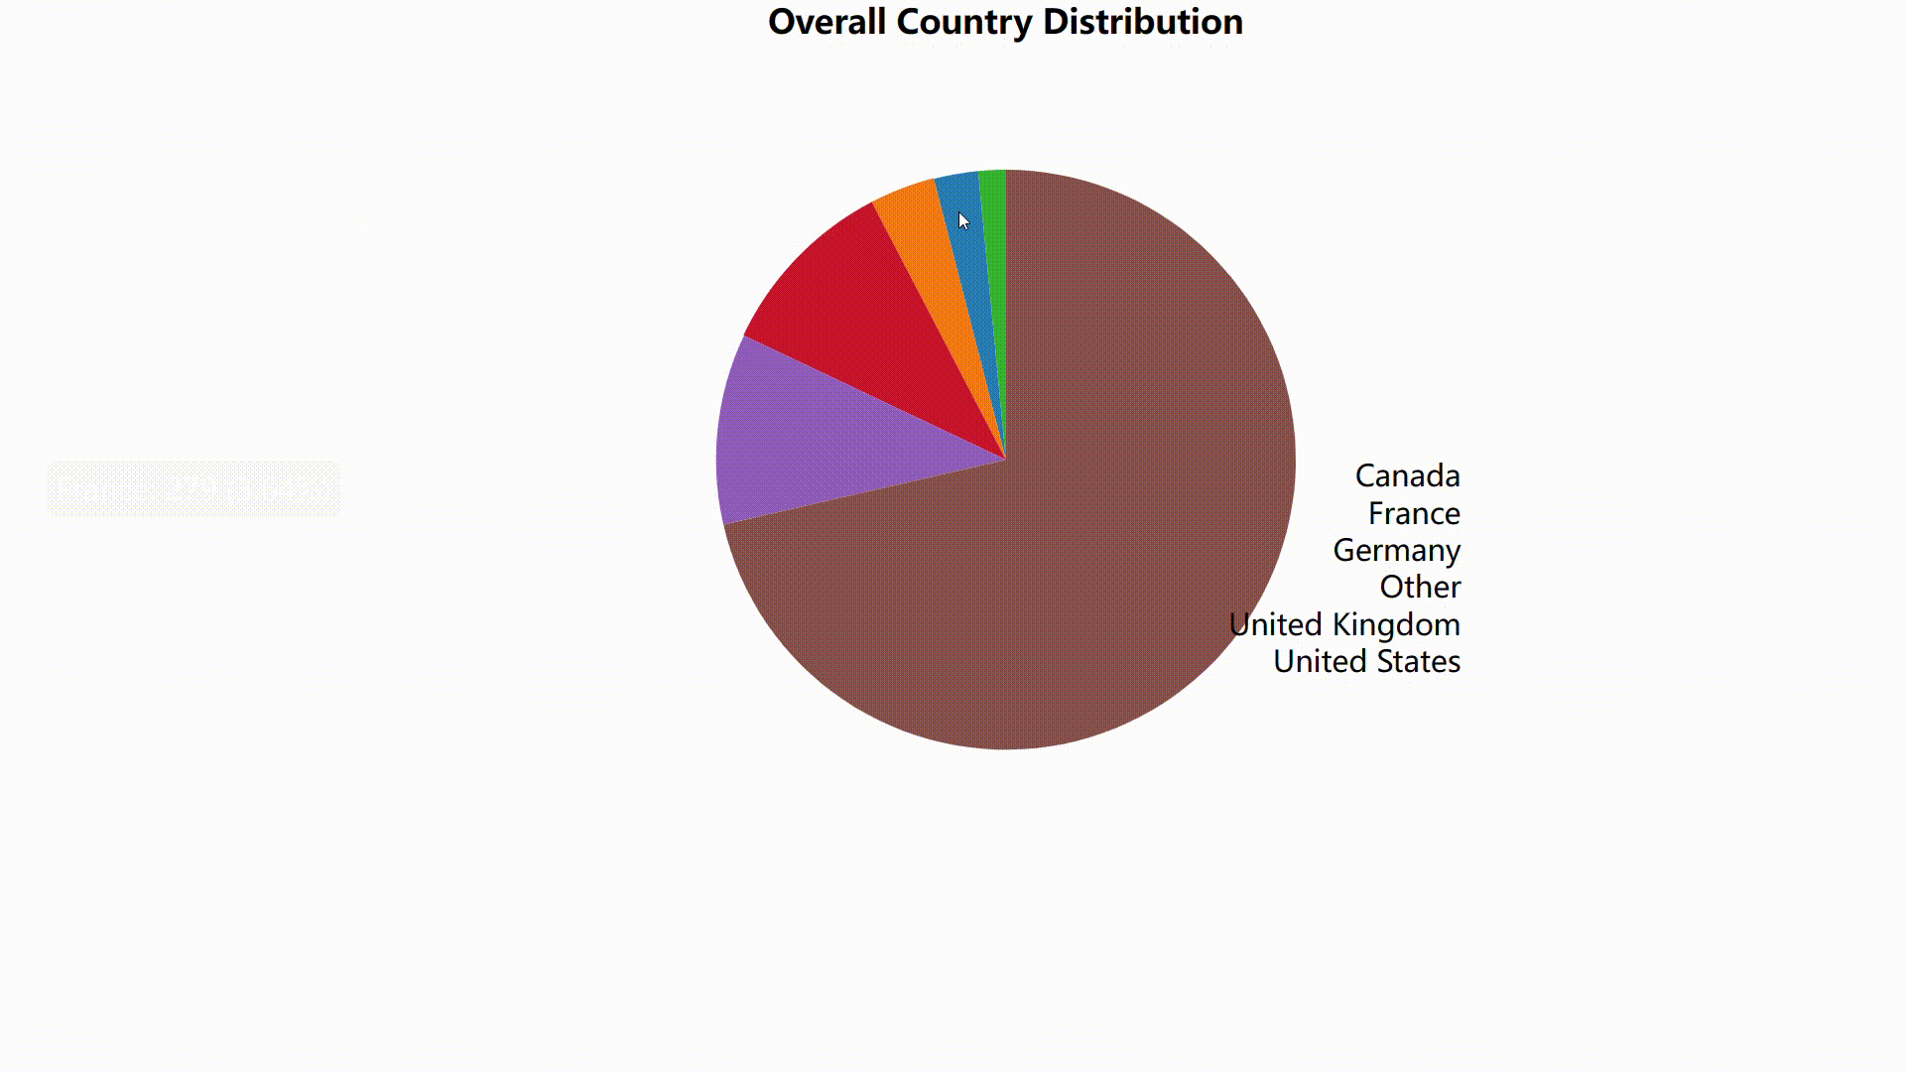
RELEASE COUNTRY
Compared various features across countries

Slide 12
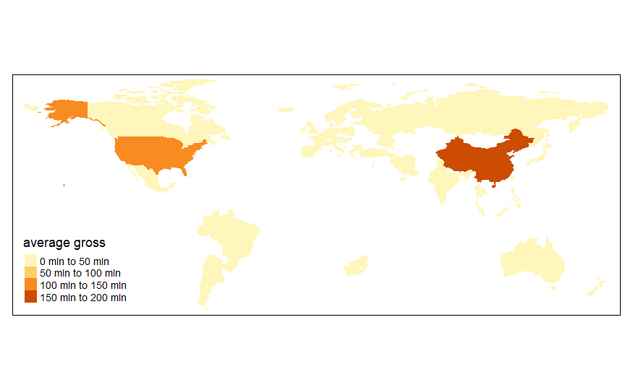
RELEASE COUNTRY
Compared various features across countries

Slide 13
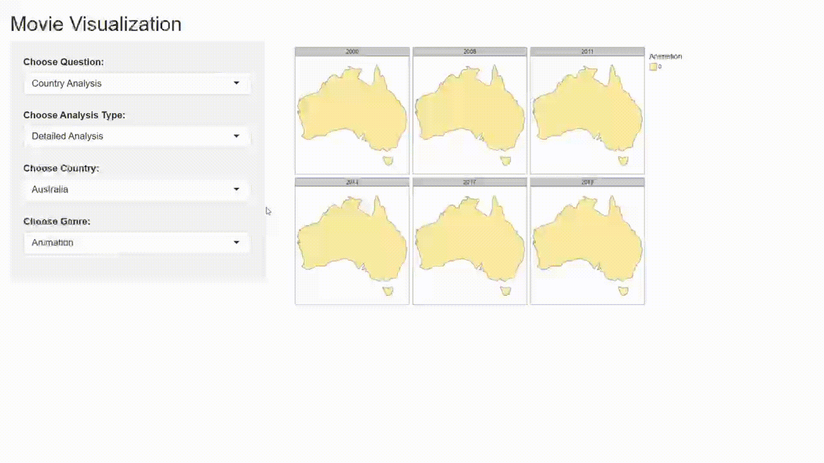
RELEASE COUNTRY
Compared various features across countries

Slide 14

03
DIRECTORS / ACTORS

Slide 15
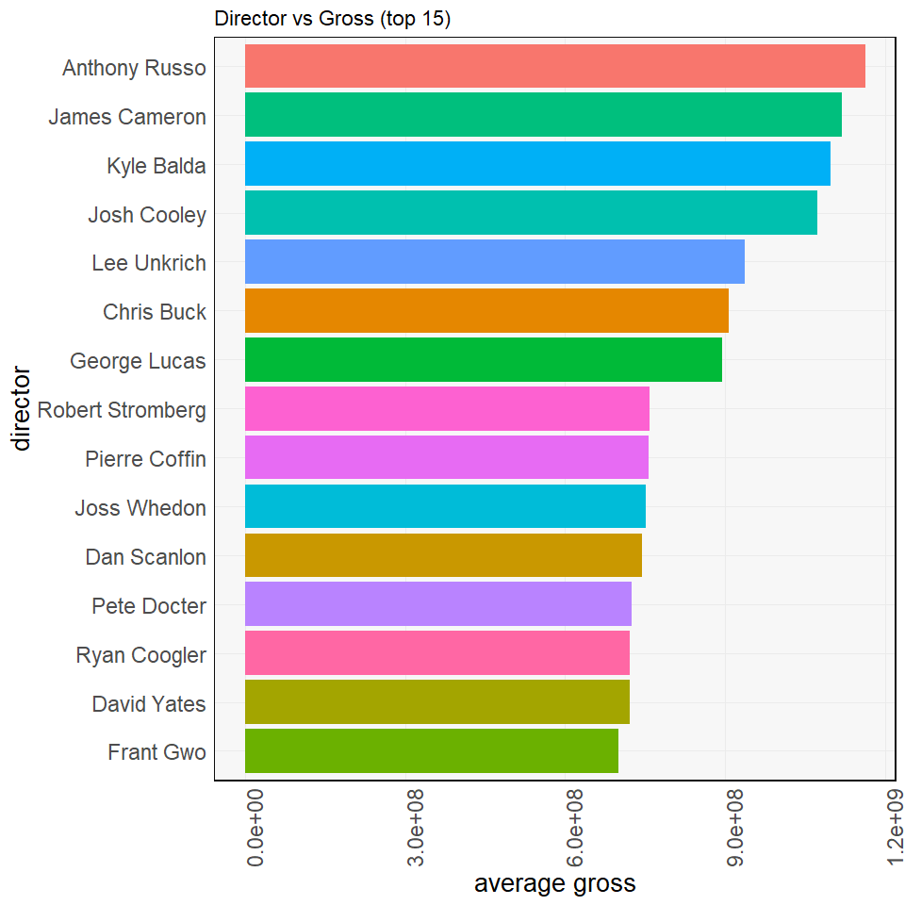
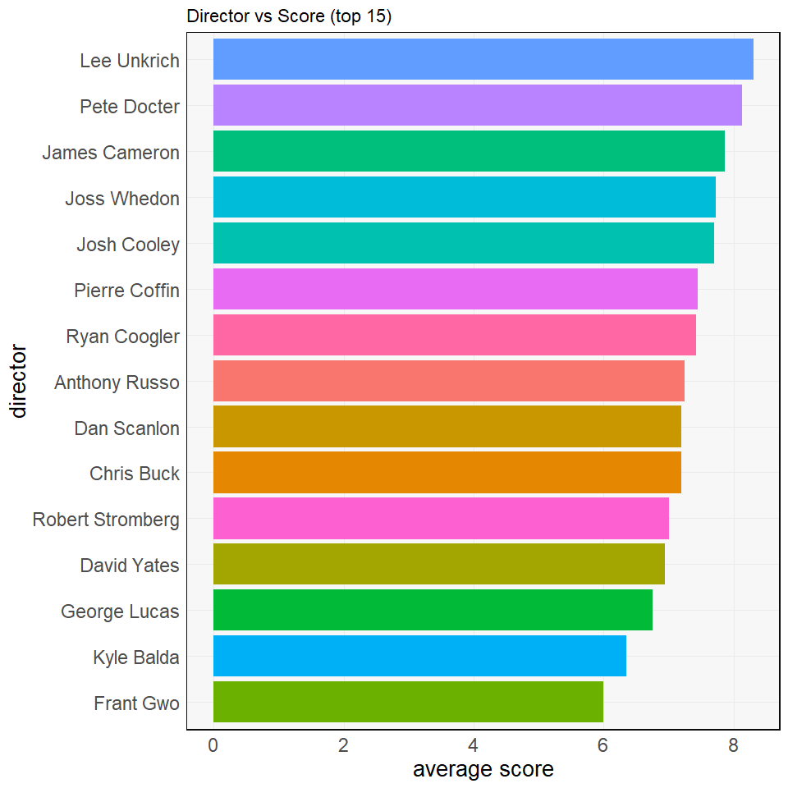
DIRECTOR vs. GROSS / SCORE

Slide 16
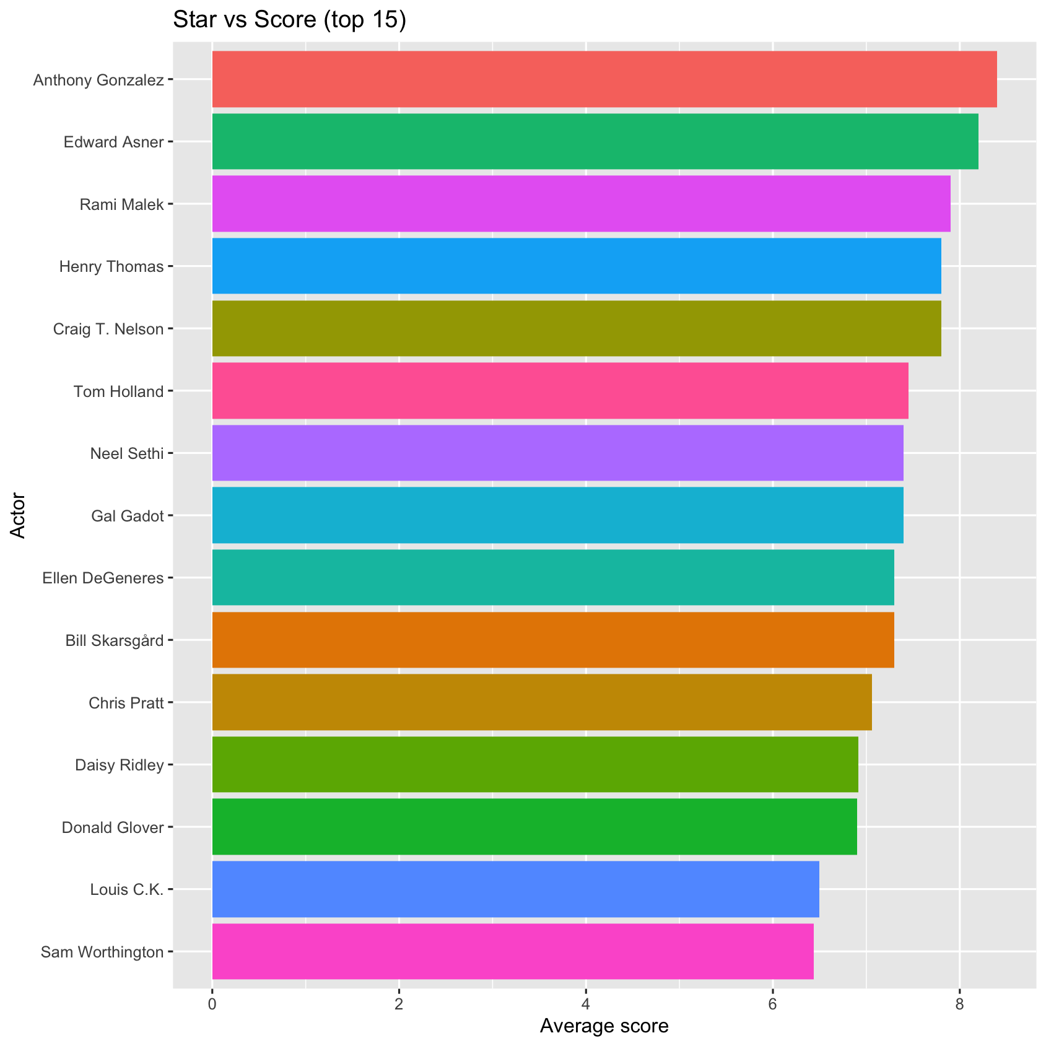
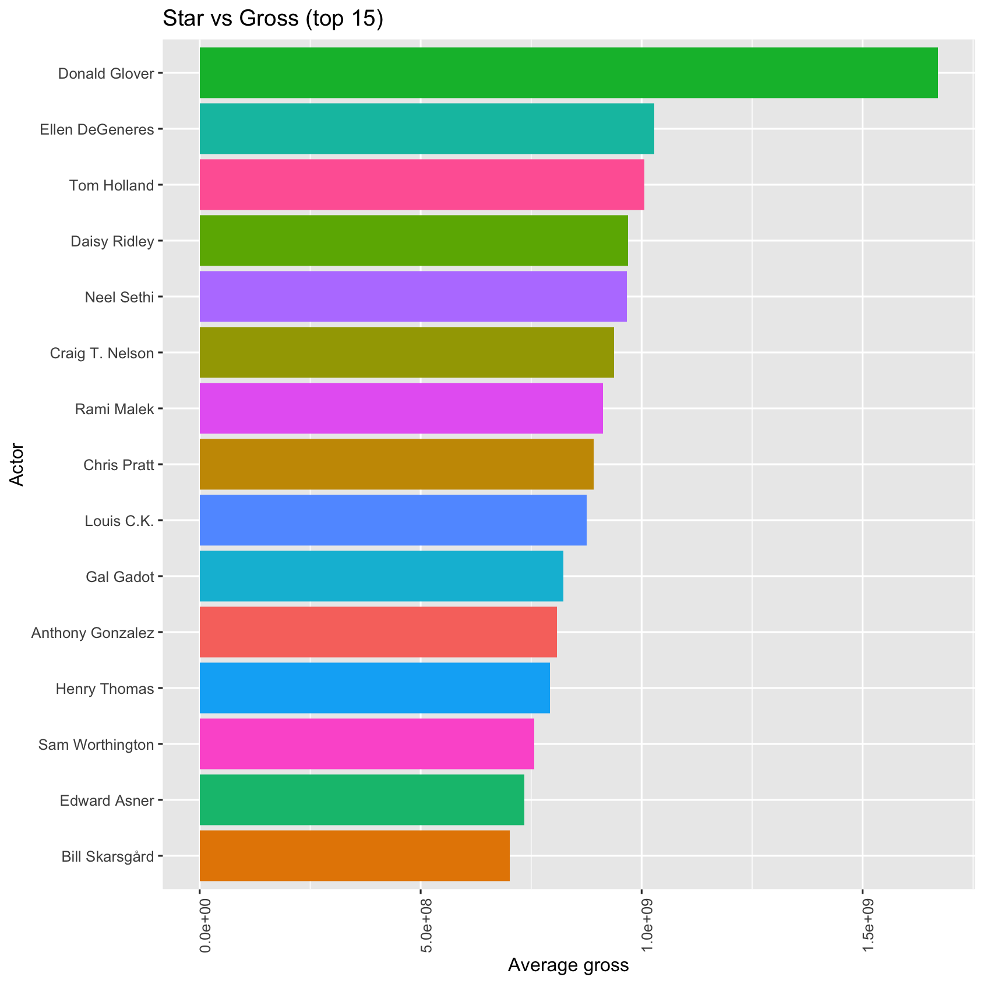
STAR vs. GROSS / SCORE

Slide 17
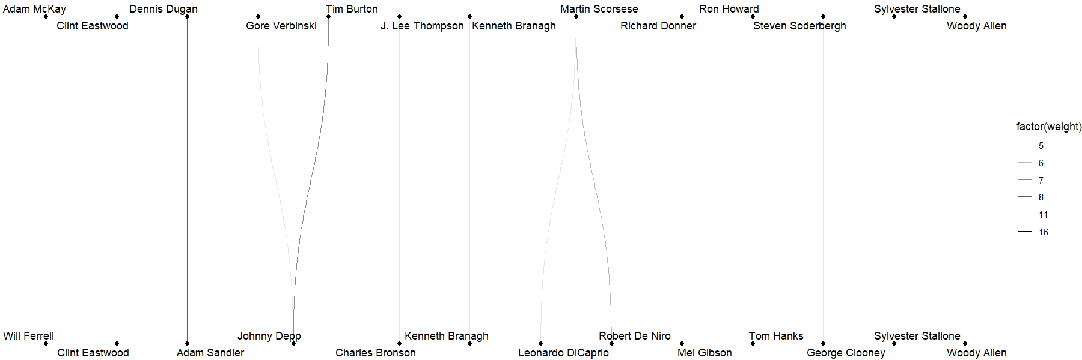
Director vs. Star

Slide 18

04
MOVIE LENGTH

Slide 19
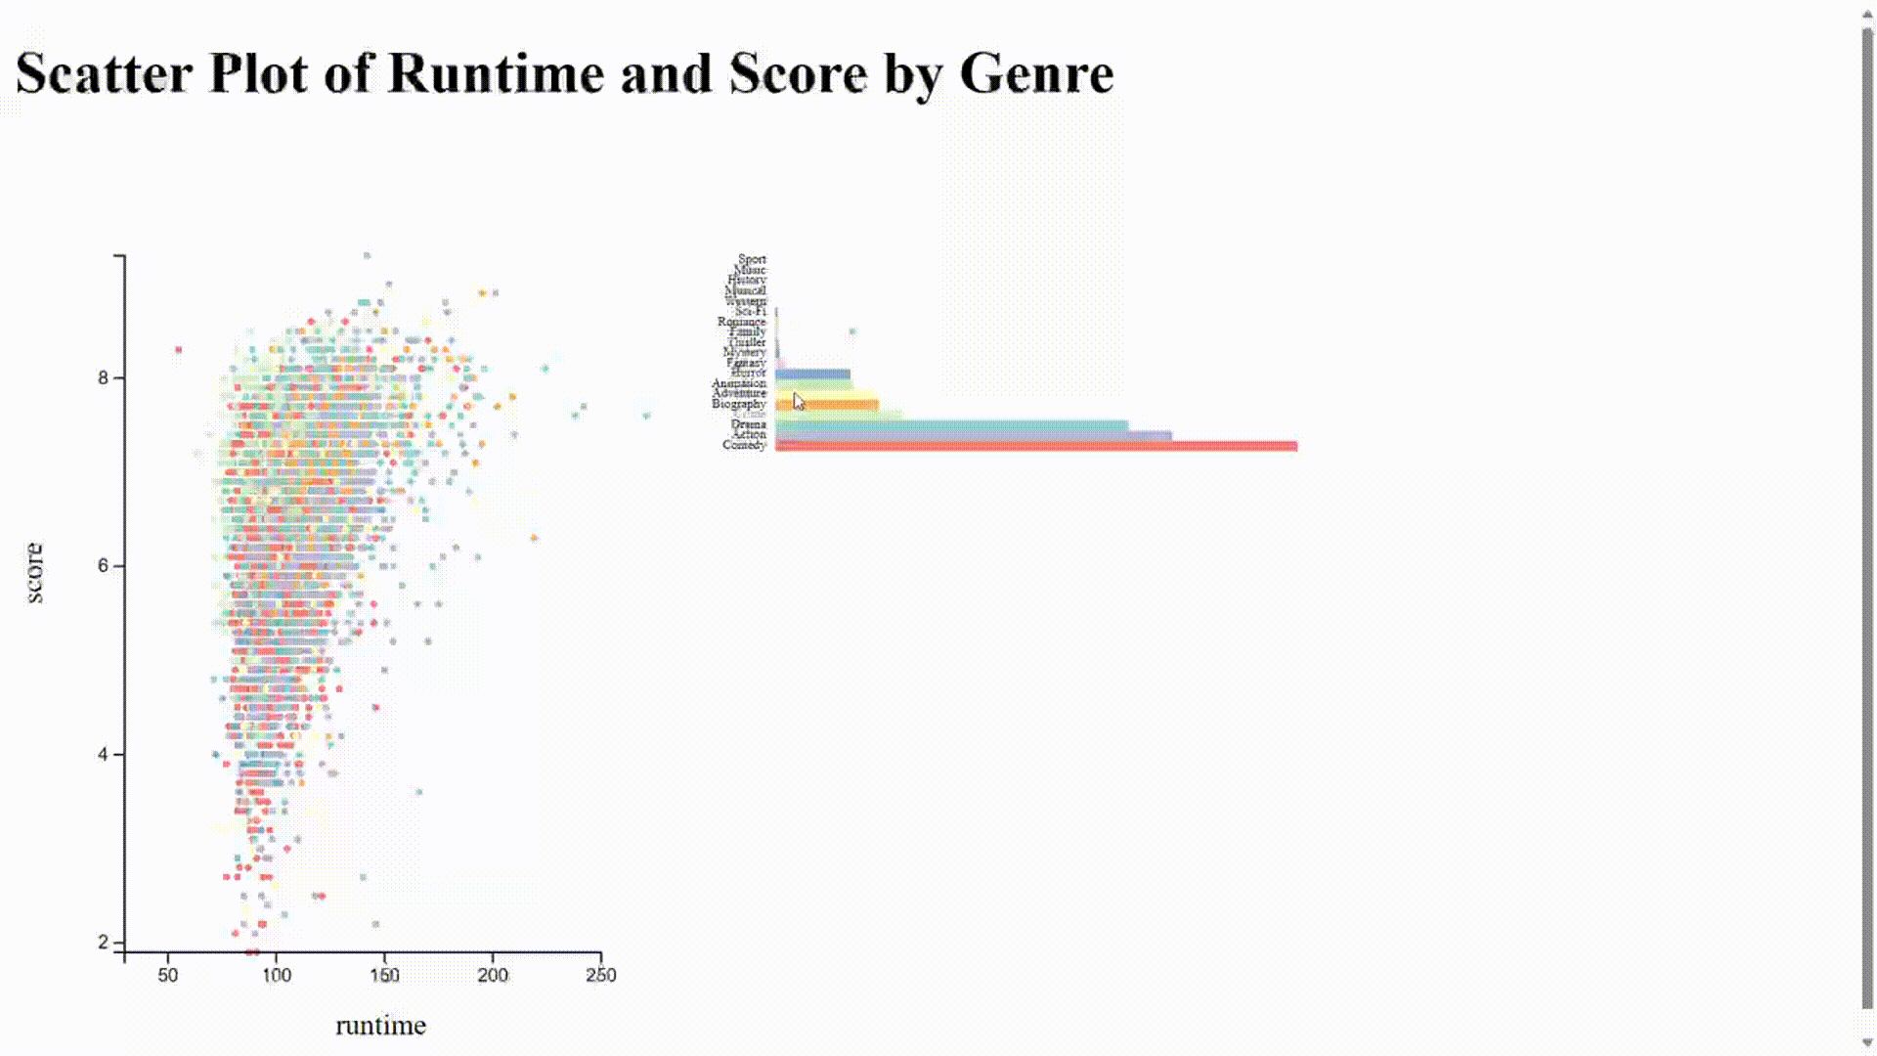
RUNTIME vs. GROSS by GENRE

Slide 20
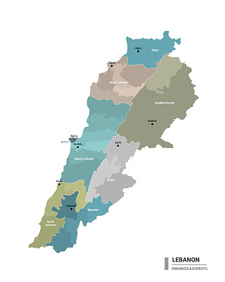



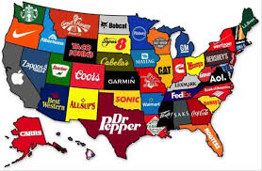
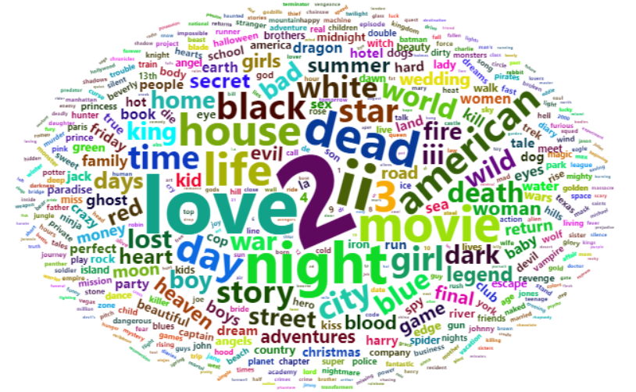
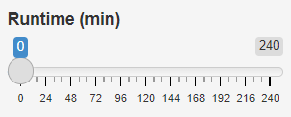
PREDICTION
Release Region
Release Month
Assumption: More average gross this feature brings, more important impact this feature makes
Release Year
Genre
Runtime

Slide 21
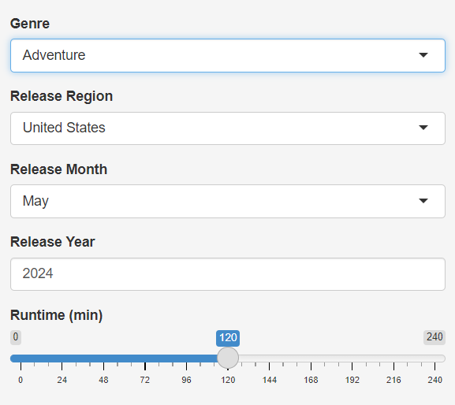
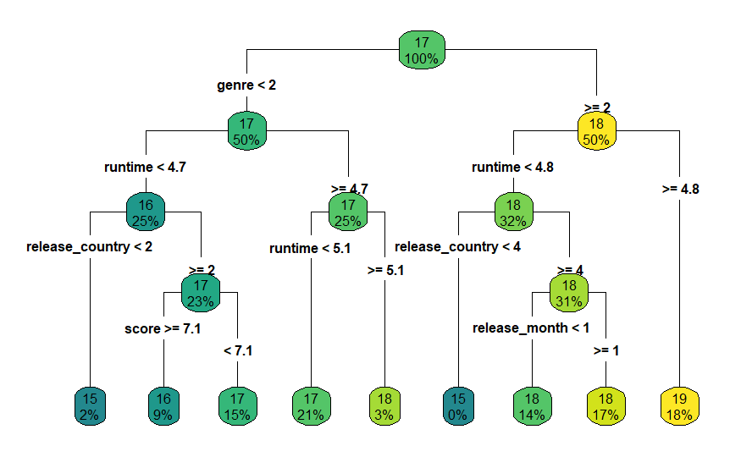
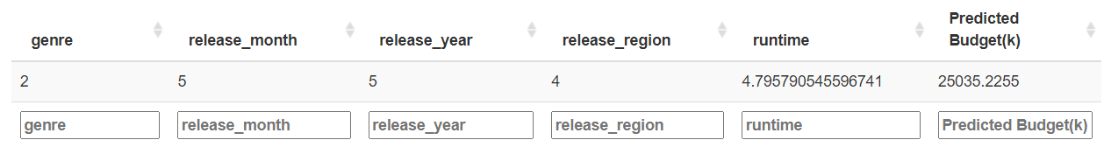
Decision Tree Model & Prediction

Slide 22

1
SHINY APP LINK
https://siyanwang.shinyapps.io/679groupproject
2
GitHub LINK
https://github.com/feiyunyan2333/stat679_proj
3
D3 VISUALIZATION
https://vivianbeagle.github.io/STAT679/pie.html
https://vivianbeagle.github.io/STAT679/runtime.html

Slide 23

THANK
YOU!

